Slide 1
Logging In
email for students

Slide 2
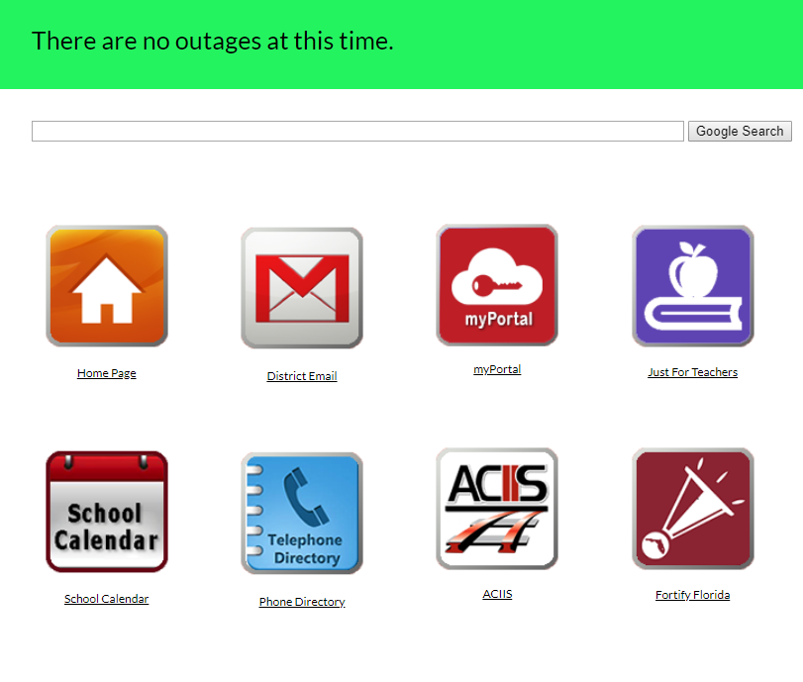
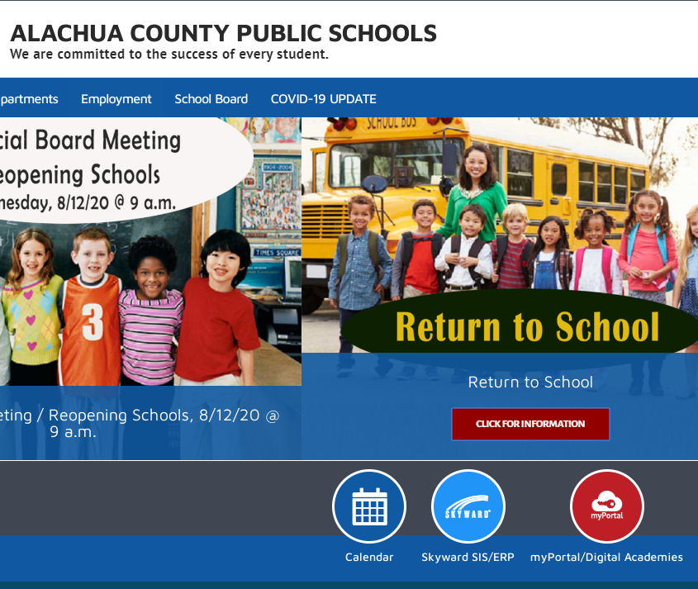
FINDING THE LINK TO CANVAS
https://sites.google.com/gm.sbac.edu/launchpad/just4students OR... https://www.sbac.edu/

Slide 3
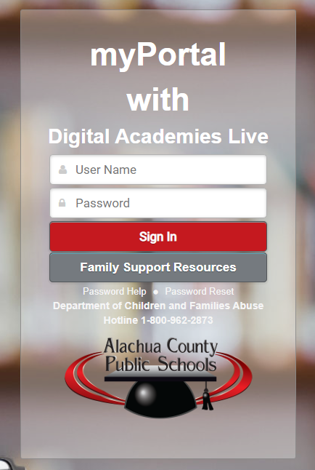
Student username and password
If your child cannot remember their username or password, visit
https://docs.google.com/document/d/1h2PgYSIF0ikt-kOKg2rwklBFgpR8paGCi5BSfqU8HGI/edit

Slide 4
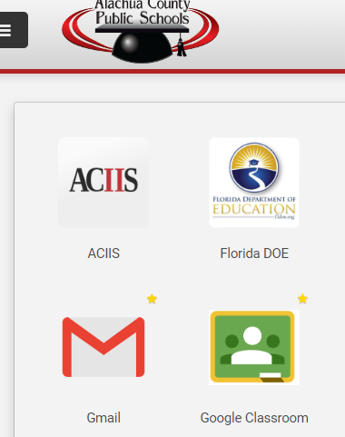
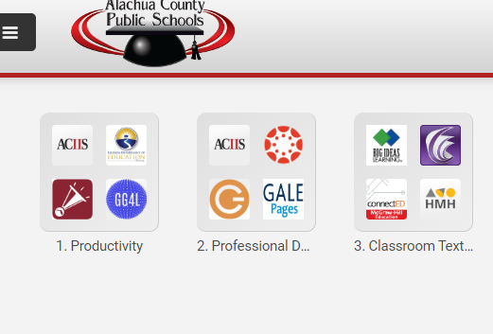
Finding Canvas within the student portal
Step 1 - click the icon for productivity
Step 2 - click on the link for Gmail

Slide 5
Once logged in, your student should see all of emails
NOTE - student emails are protected by district filters; they will only be able to receive emails from other school email users or district approved outside websites.

Slide 6
If you are having any issues accessing email, please contact:
Your child’s teacher via email
Kanapaha Middle School at 352-955-6960

